Slide 1


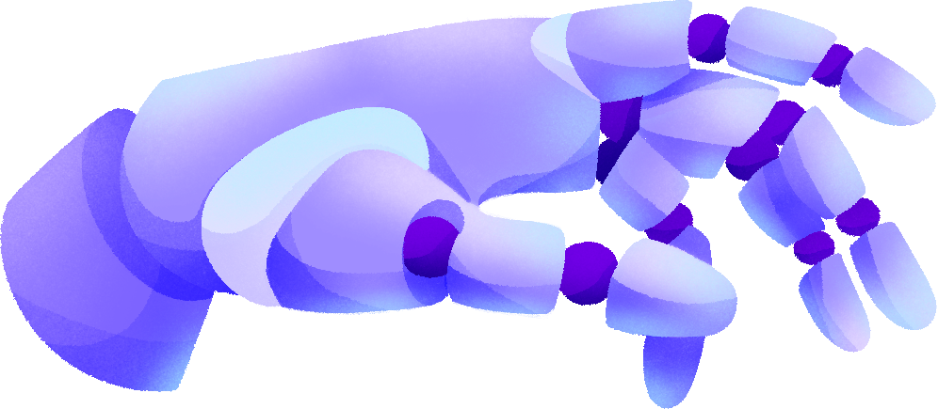

AI-DRIVEN THREAT DETECTION
AND RESPONSE
Alex Lappin, Sumayah Alomari, Bibhu Padyual, Josh Puyat, Mahi Khan, Hussam Al Bakhat
Sponsor: Zhengdao Wang
Mentor: Alexandre Barreto

Slide 2

TABLE OF CONTENTS
Introduction
Demo
Overview
Conclusion
Supervised multiclass training method
Questions
IDS improvement

Slide 3
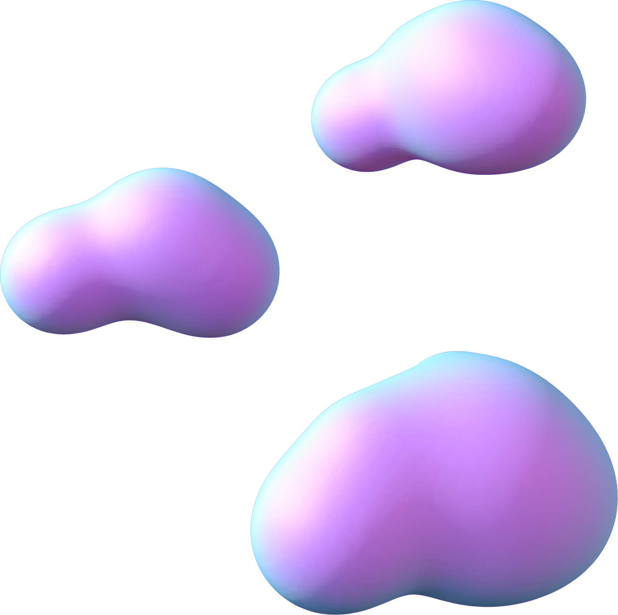
INTRODUCTION

Slide 4

CURRENT PROBLEM
Static & Outdated
Rely on rigid, signature-based rules
Cannot learn or adapt to new threats
High False Positives
Irrelevant alerts cause fatigue
Slows down real threat response
Evolving Threat Landscape
Rise in zero-day exploits and APTs
Existing tools struggle with unseen patterns
Not Built for Real-Time Defense
Lack scalability and intelligence
Fail to analyze live, complex traffic flows
Goal of this project
Bridge the gap by developing an AI-driven IDS
Deep learning for smarter detection
Explainable AI for transparency
Cloud-native tools (AWS, Suricata, etc.) for scalability and safe testing

Slide 5


ENVIRONMENT

Slide 6

PROOF OF CONCEPT
What Tools Were Used?
AWS EC2: For secure and scalable virtual testing
GNS3: Simulated realistic network topologies
Suricata: Core intrusion detection system
CICFlowMeter: Converted PCAP traffic into ML-ready CSVs
Purpose of the Environment
Create an isolated but realistic simulation space
Train, test, and validate AI-enhanced intrusion detection
Safely replicate benign and attack traffic scenarios

Slide 7
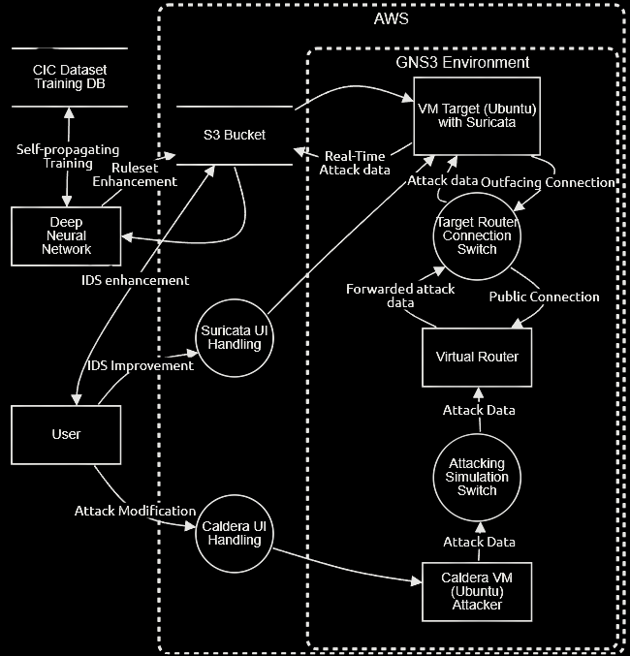
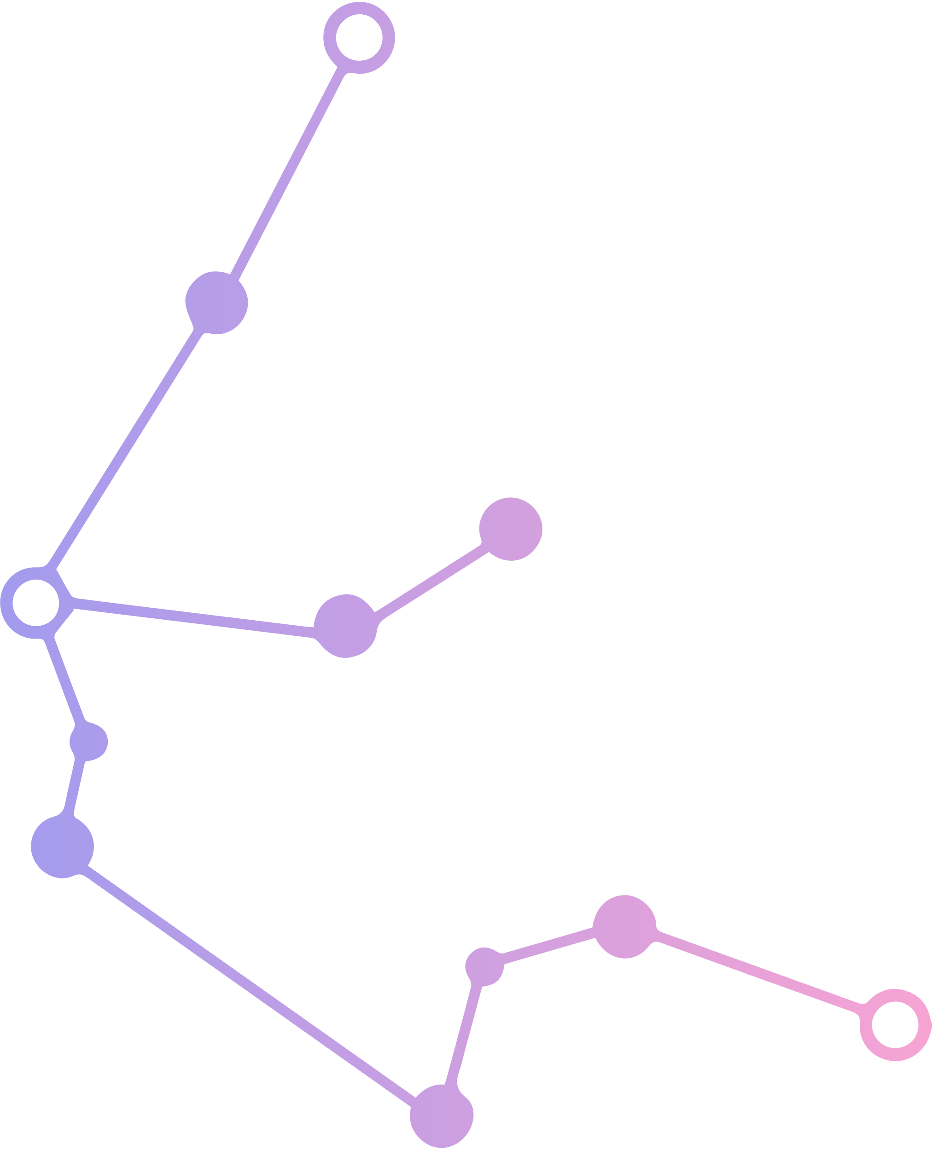
ENVIRONMENT
Proof-of-Concept Architecture
GNS3-Simulated network environment
AI components from AWS for training & feedback
Process Flow
Attacker VM launches simulated threats
Virtual Router & Switches route traffic to the target
Suricata IDS captures events + pcaps → uploads to S3 bucket
Deep Neural Network (AWS)
Classifies traffic
Labels attacks
Triggers rule updates
User Interaction
Monitors detections & system performance
Triggers enhancement scripts via ChatGPT API
Updates Suricata with new .yaml & .rule files

Slide 8






WHAT IS AN IDS?
Monitors network/system activity
Detection Types:
Signature-based: Matches known threat patterns
Anomaly-based: Flags unusual behavior
Alerts admins when suspicious activity is found
Proactive layer against cyber threats
IDS Types:
NIDS: Network-level monitoring
HIDS: Host-level monitoring
NIDS
HIDS

Slide 9
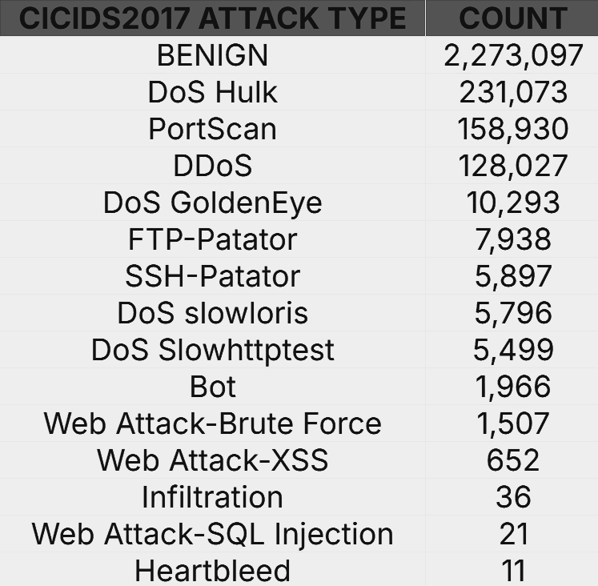

OUR DATASET
Created by Canadian Institute of Cybersecurity (CIC)
Emulates real-world traffic: email, browsing, file transfer
Includes 14 Attack types + benign traffic
Flows were captured via tcpdump
Ideal for ML model training due to attack realism

Slide 10


Establish Attack Schedule
Clear Logs
Run Suricata
ATTACK SIMULATION
Phase 01
Overlay Precision Time Display
Simulate Benign Traffic
Verify Log Generation
Run Attack Script for Desired Time
Phase 02
Send PCAP file to S3 Bucket
Run the file through CICFlowmeter
Confirm 84 Features
Phase 03

Slide 11


WHY DNN?
CNN Under-performed on PCAP Data
CNN with temporal data vs tabular Network data
Precision and Class Imbalance Issues
CNN biased prediction towards majority with low precision for small classes
Feature Independence not Exploited by CNN
PCAP features are semantically independent with no local relationship
DNN Suited for Global Pattern Recognition
Treats all features equally in connected layers for complex interactions

Slide 12
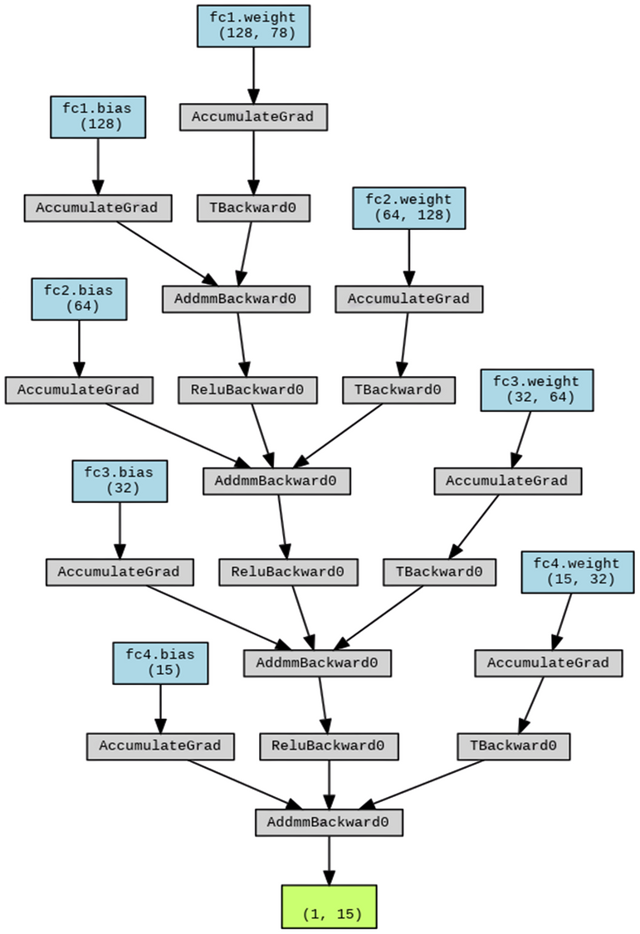
THE DNN
DNN Structure
4 fully connected layers [78 input features → 128 → 64 → 32 → 15 output classes]
PyTorch Lightning for modularity and ease of experimentation
Layers:
Dense (linear) layers for full inter-feature connectivity
ReLU Activation functions between layers
Softmax at the output layer → probability distributions over 15 classes
Loss Function: Focal Loss over Cross Entropy
Cross entropy performed poorly on imbalanced classes
Focal loss improves detection on low-frequency attacks

Slide 13
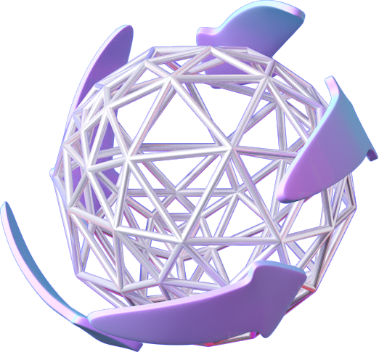
SUPERVISED MULTICLASS TRAINING METHOD

Slide 14

PREPROCESSING AND
TRAINING
Data Preprocessing
Merged CICIDS into one dataset
Removed noise (IPs), cleaned NaNs
Label-encoded attacks (0-14)
Normalized features [0-1]
Calculated class-based sample weights
DNN Training
90/10 stratified train-test split
Trained on Google Colab Pro (L4 GPU, 125 epochs)
Training loop: Forward → Focal Loss → Backward → Update
Notes:
• Train/Test Split:
90% training, 10% test, stratified by label to preserve class distribution.
• Environment:
Trained on Google Colab Pro using an L4 GPU (24GB VRAM).
• Epochs:
Model trained over 125 epochs for convergence.
• Training Flow:
Forward pass → Focal Loss → Backward pass → Weight update.
• Class Imbalance:
WeightedRandomSampler used to oversample minority classes.
• Callbacks:
EarlyStopping (prevent overfitting), ModelCheckpoint (save best model).

Slide 15
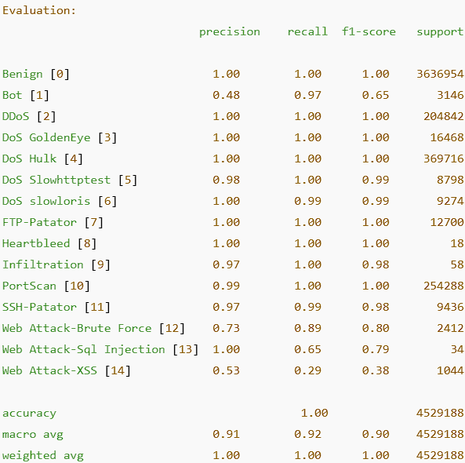
RESULTS PT1
Macro F1 Score: 0.90
High macro precision and recall
Strong on DoS Hulk, Port Scan
Small classes represented

Slide 16
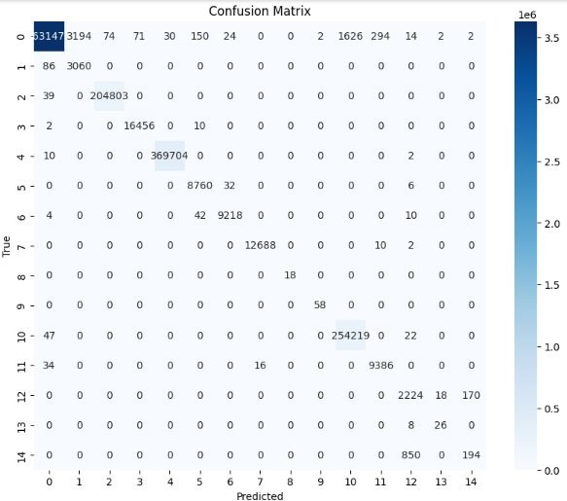
RESULTS PT2
Majority predictions correct (diagonal)
4.5M instances across 15 attack types
XSS: Low F1 (0.38), misclassified as Brute Force
Bot: High recall, low precision (false postives)
Prioritized recall → fewer false negatives

Slide 17
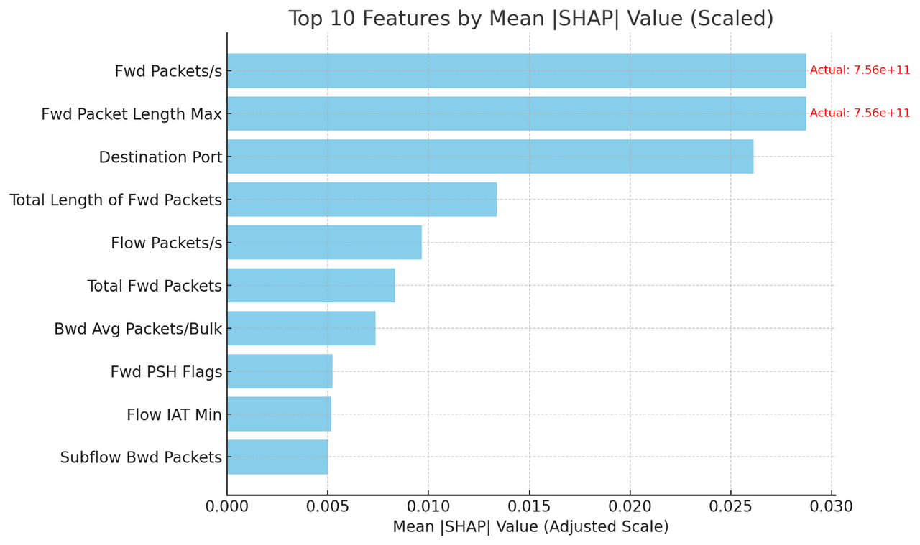
RESULTS PT3
SHAP explains model decisions
Top features
Fwd Packets/s (rate)
Fws Packet Length Max (size)
Adds transparency
Aligns with NIST explainability standards

Slide 18
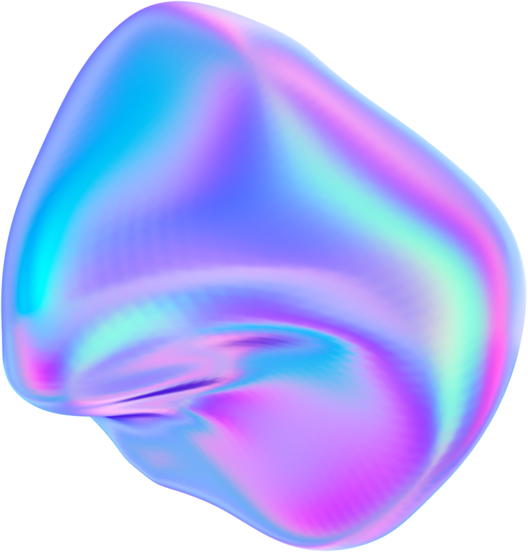


IDS IMPROVEMENT

Slide 19

DNN POST EVALULATION AND LABEL FUNCTION
Cleaned & aligned test data
Labeled with trained model
Outputs saved for Suricata
Evaluation tools: Confusion matrix, SHAP, F1 table

Slide 20
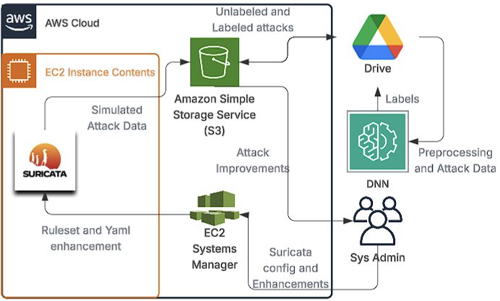
imPROVEMENTS OF THE IDS
Planned: AI → Suricata via Lambda & API
Actual: Team acted as admin; manually analyzed outputs
Scripted Enhancements:
Pulled attack names
Used ChatGPT to describe attacks
Suggested YAML updates
Example: DoS Hulk undetected → added signature
Why: Proof-of-concept for scalable, self-improving IDS

Slide 21
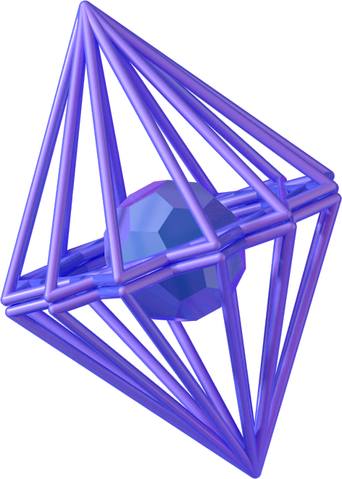
DEMO
Link: https://youtu.be/aMvX3Vj3DY4

Slide 22

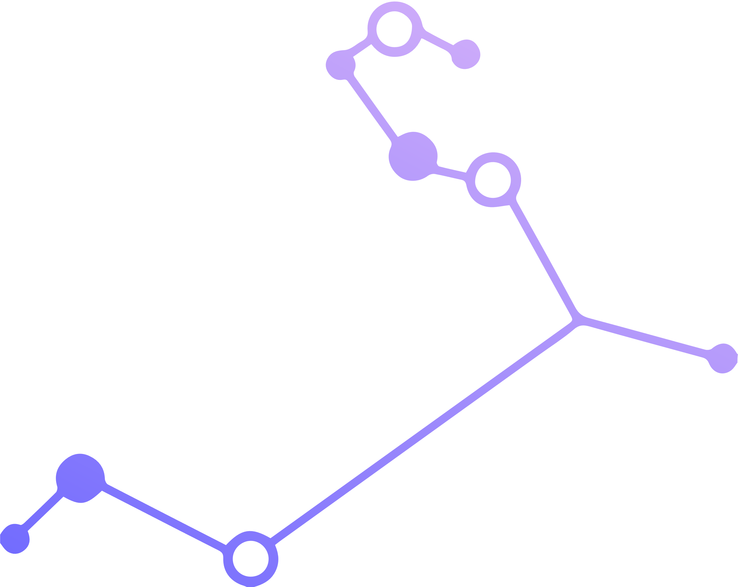
CONCLUSION

Slide 23


FUTURE WORKS
Use GNS3 + MITRE Caldera for full network + real attack simulation.
Enable Real-Time Defense with Suricata IPS + AI-labeled traffic.
Expand AI Use across SIEM, SOAR, and EDR tools.
Support Open-Source Growth for enterprise adaptation and scaling.

Slide 24

CONCLUSION
Suricata + DNN → 0.90 Macro F1 on CICIDS2017
SHAP + Confusion Matrix → Model explainability & trust
Feedback Loop: Model → Rules → Suricata
Lays groundwork for adaptive, self-healing IDS/IPS

Slide 25

QUESTIONS

